Slide 1
Java Collection Framework
Abdul Mannan Mohammed
SE450: Object Oriented Software Development
11-11-2023

Slide 2
Introduction
Java Collection Framework is a vital toolkit in Java programming as it provides a comprehensive set of data structures and classes for managing various data objects.
It was first released with Java 12.
It makes it easier to store and manipulate a wide variety of collections of objects.
These objects include lists, sets, queues and maps.
Notes:
The Java Collection Framework, or JCF, is a vital toolkit in Java programming because it provides a comprehensive set of data structures and classes for managing a collection of objects [1].
This principle is extremely important in object-oriented programming. JCF makes it easier to store and manipulate a broad variety of collections of objects such as lists, sets, queues, and maps. As a result, it plays an important part in a variety of software applications.
Java Collection Framework gained its significance in the early days of Java, it came with Java 12 [3]. The framework consolidated a collection of classes into a single unified framework. It brought about standardization on how to handle different data structures using Java.

Slide 3
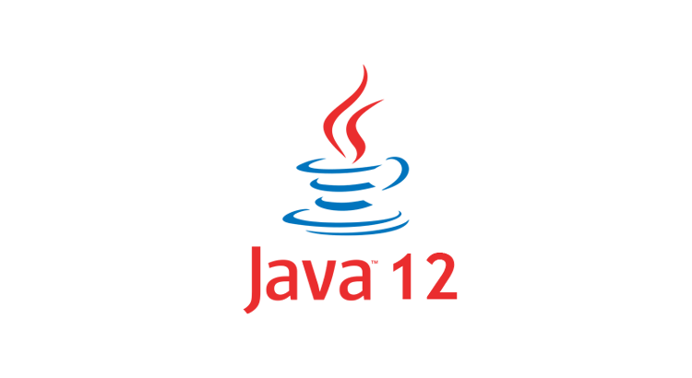
Development and Evolution
The Java Collection Framework was first introduced in Java 12.
Starting with Java 12 the framework has gotten better and better.
The framework combined a number of classes into a single, cohesive framework.
The core classes include: Hash Maps, Array Lists and Linked Lists.
Notes:
Java Collection Framework rose to prominence in the early days of Java, arriving with Java 12 [3]. The framework combined a number of classes into a single, cohesive framework. It resulted in standardization of how to handle various data structures in Java. The framework’s core classes include HashMaps, ArrayLists and LinkedLists [3].

Slide 4
Every major release of Java since Java 12 has sought to make the framework better and better.
This is aimed at making it relevant and applicable to the ever changing technological landscape.
With Java 12 release, Switch expressions were added. It interfered with the syntax but greatly improved the readability of the code.
As a result, data manipulation became more elegant and intuitive
Notes:
The framework has experienced a number of changes since its beginnings in Java 12. Since Java 12, every major release has included updates and improved capabilities that have solidified the framework's use as an important tool for Java developers. Switch expressions were added in Java 12 with the release. This provided a more succinct and versatile approach of dealing with conditional logic. This update had a significant impact on the language syntax, but it increased the readability of code written with the framework. This was accomplished by the simplification of coding constructs. As a result, data manipulation became more elegant and intuitive.

Slide 5
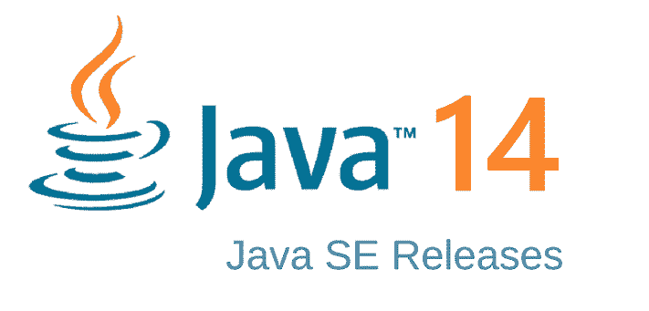
Java 14 continued to improve the framework.
The release marked a significant enhancement in the framework's immutability characteristics.
The "of" factory methods, which are used to generate immutable collections, were introduced in this release.
The Java Collection Framework therefore became more relevant and valuable in current software engineering.
Notes:
With the release of Java 14, the framework continues to evolve. This release marked a significant enhancement in the framework's immutability characteristics.
The "of" factory methods, which are used to generate immutable collections, were introduced in this release. This was a substantial improvement to the framework.
It ensures data integrity and safety in a variety of applications, particularly multi-threaded applications. As a result, they are critical in modern software development.
The upgrades continue to improve the language, the framework, and the libraries. As a result, the Java Collection Framework becomes more relevant and valuable in current software engineering.

Slide 6
JCF Applications
Due to its versatility and efficiency, the framework can be used in the following applications.
Big Data
Cloud Computing
Microservices
Notes:
Big Data, microservices, and cloud computing are driving the modern world. Because of its versatility and efficiency, the framework is in high demand in such applications. Businesses and organizations now rely on big data as an essential component of their decision-making processes. The Java Collection Framework has been used to create a number of technologies, including Hadoop and Spark, which have considerably enhanced data processing [2].

Slide 7

Big Data
Through Java Collection Framework large datasets are able to be stored and analyzed efficiently and accurately.
The framework efficiently manages data storage and retrieval.
Data processing processes in distributed systems like Hadoop rely on the framework's data manipulation functionality
Notes:
This has been accomplished because the framework allows for the storing and analysis of large datasets. The framework efficiently manages data storage and retrieval. Data processing processes in distributed systems like Hadoop rely on the framework's data manipulation functionality. In this context, the Hadoop MapReduce paradigm provides the capacity to efficiently manage data processing during the reduction phase [2].

Slide 8
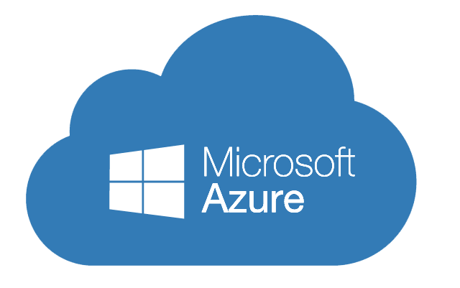

Cloud Computing
Cloud computing relies on cloud computing platforms which are integrated with the Java Collection Framework.
.The integration's goal is to make data administration easier for developers creating cloud-based apps.
When storing data in the cloud, for example, the storage configuration data is S3 bucket in Amazon Web Services, or when managing key-value pairs in a NoSQL database such as Mongo DB, the Java Collection Framework provides the essential tools
Notes:
Cloud computing platforms are also using the Java Collection Framework [2]. The market leaders in this domain, Amazon Web Services and Microsoft Azure, have integrated the Java Collection Framework into their software development kits and other services. The integration's goal is to make data administration easier for developers creating cloud-based apps. When storing data in the cloud, for example, the storage configuration data is S3 bucket in Amazon Web Services, or when managing key-value pairs in a NoSQL database such as Mongo DB, the Java Collection Framework provides the essential tools. This simplifies cloud storage.

Slide 9

Microservices
Microservices refers to software architectural style where applications are developed as a collection of distributed services, each with its unique role.
Java Collection Framework enables lightweight and self-contained components.
It ensures data sharing and management is extremely efficient
Notes:
The framework's capabilities have also had an impact on the rising use of microservices architecture. Microservices explain how modern applications are designed and distributed [4]. It enables lightweight and self-contained components. To accomplish this, data sharing and management must be extremely efficient. The Java Collection Framework comes into play here. Because of its versatility and performance, the framework is ideal for microservices development. As a result, the framework optimizes data access between diverse services by enabling effective data storage and retrieval [4]. As a result, the framework is adaptive to current software development trends. Making it beneficial in a variety of use scenarios like as Big Data, Microservices, and Cloud Computing.

Slide 10
Challenges
Lack of support for persistent data structures.
These persistent data structures allow applications to store and generate previous data versions.
These data structures are essential in applications like version control systems
Notes:
Despite its numerous applications and benefits, the framework confronts numerous obstacles in the context of software development. The absence of built-in support for persistent data structures is one of the framework's challenges. These persistent data structures allow applications to store and generate previous data versions. These data structures are essential in applications like version control systems. Because Java's standard collection classes do not provide permanent data structures, this is the case. This forces developers to consider alternatives such as customizing solutions or relying on third-party libraries. These add complexity and are potential sources of error when running the program, which can have a substantial impact on performance.

Slide 11
Lack of Parallelism.
Parallelism in Java refers to breaking down a problem into subproblems and solving each one concurrently before integrating the results.
Not every standard collection can be parallelized within the framework presenting a challenge.
Notes:
The other difficulty is related to parallelism. Parallelism in Java refers to breaking down a problem into subproblems and solving each one concurrently before integrating the results. For concurrent data structures, Java only provides the 'java.util.concurrent' package. This, however, is only applicable in a subset of operations. Not every standard collection can be parallelized. When iterating over members in a List, for example, where each element involves a sophisticated operation, the advantages of multi-core processors are not completely exploited. This causes performance concerns, making the framework unsuitable for multi-threaded applications [4].

Slide 12
References
[1] Horstmann, C. S. (2019). Core Java Volume I - Fundamentals (11th ed.). Pearson.
[2] Jules, S., & Anderson, M. (2019). Big Data Processing with Hadoop. O'Reilly Media.
[3] Oracle. (2020). The Java™ Tutorials - Collections. Oracle Documentation.
[4] Vohra, A. (2020). Java Microservices. Apress.

